Slide 1
Extracting Chemical Ingredients with Machine Learning and Quadgrams
Erick Saenz
Mentor: Dr. Hsu

Slide 2
Objectives
Get to the point
What is a recipe?
What is the Naïve Bayes Classifier? Additional Modules used
How can we use Part-of-speech Quadgrams to train a Classifier?
Our Results
How are we improving this research

Slide 3
What’s the Point?
Improve Science communication
Reads papers in seconds

Slide 4
Recipe
The ingredients list
The
“What to do with the ingredients”
list

Slide 5

Example of Trigrams
Example of Quadgrams
1 gallon of Milk
2Lbs of Meat
Dozen of Eggs
5Lbs of Potatoes
http://www.quotidian.us/notebook-paper-template
1mol of Hydrochloric Acid
1mol of sulfuric Acid
500ml of isopropyl alcohol
CTAB (2mM)

Slide 6
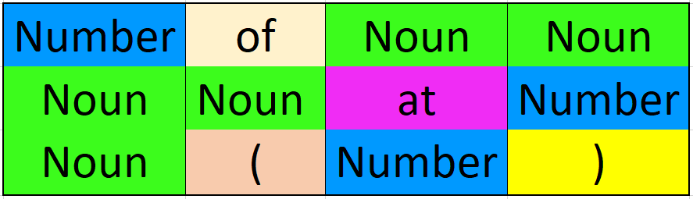
Convert these ingredients to Parts of Speech
1
2
3
4
Example 1
Example 2
Example 3
Natural Language Toolkit (NLTK) module Part of speech Tagger was used for this Conversion

Slide 7
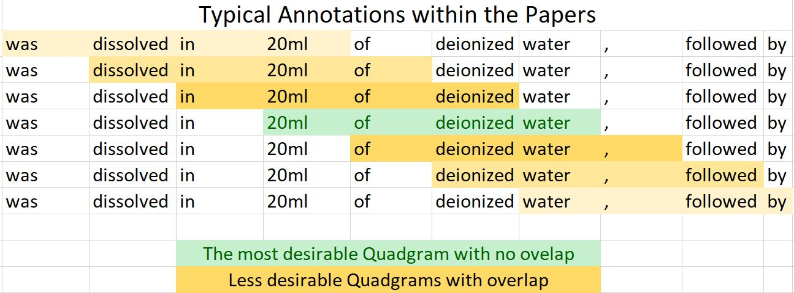
Avoiding Overlap
Here we see the ingredient is made up by four words within the text

Slide 8
Naïve Bayes Classifier
Independent of context
Must be trained
Can predict positive and Negative Quadgrams on Tests

Slide 9
Training the Classifier
Trained it with 100 positive Quadgram
Train with additional 100 negative Quadgram

Slide 10
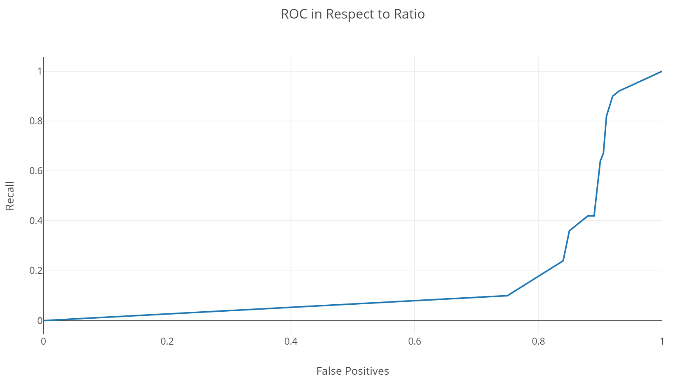
RESULTS Receiver Operating Characteristic

Slide 11
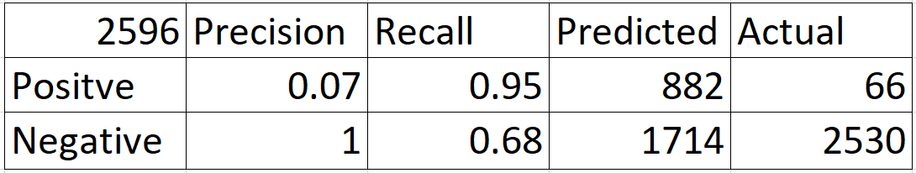
Actual Results

Slide 12
State of Repairs
Focus on experimental/methods sections
Adjust the hyperparamaters before the Machine Learns
Correct all mis-indented text
Correct all mis-Conjoined words
Correct all Super/Subscripts

Slide 13
Pattern Module by CLIPS
Has an awesome Suggest function that will make predictions on misspelled words
Happens to work on hyphenated split words as well!

Slide 14
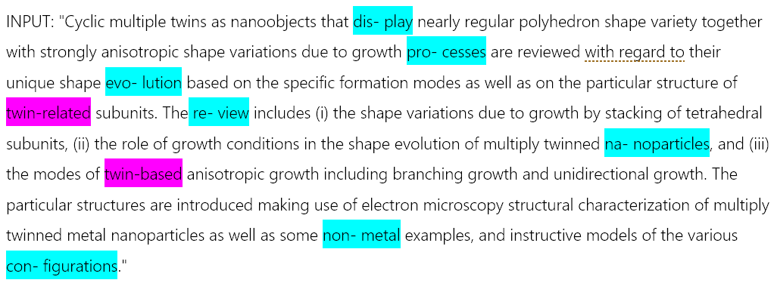
Example text from Extraction

Slide 15
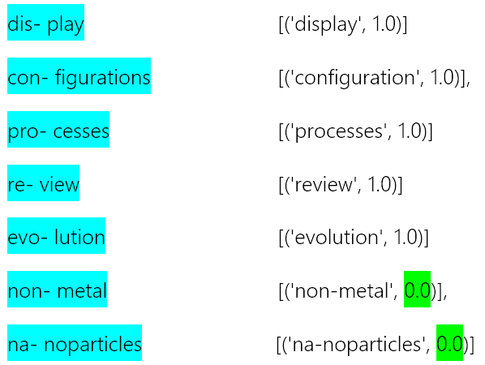


Slide 16
Viterbi Algorithm
HowDoWeBreakConjoinedWords?

Slide 18
Tongue Twisters 1

Slide 19
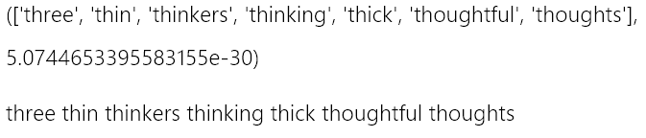
Tongue Twisters 1

Slide 20
Tongue Twisters 2

Slide 21
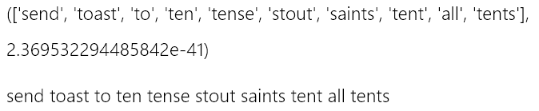
Tongue Twisters 2

Slide 22

Tongue Twisters 3

Slide 23
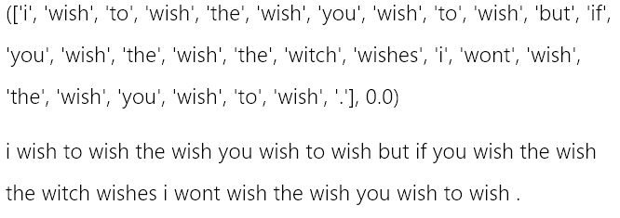
Tongue Twisters 3

Slide 24
More Things to Fix
Huge lack of vocabulary especially in science based words

Slide 25
Acknowledgments
Mentor: Dr. Hsu
McNair Managers: Cheryl Rauh, Maggie Borders
Jeanne, Dr. Green

Slide 26
Works Cited
https://www.smart-words.org/tongue-twisters.html text
http://norvig.com/spell-correct.html module
https://www.clips.uantwerpen.be/pages/pattern module
https://stackoverflow.com/questions/195010/how-can-i-split-multiple-joined-words Answered by username: Darius Bacon Edited by: kumardeepakr3
https://www.nltk.org/ module

Slide 27
Questions?

